Slide 1
Debugging Code on Kubernetes
Mark Foley
Senior Solution Engineer
Sharmyn Kayani
Associate Solution Engineer
CODE2757
#vmworld #session ID

Slide 2
Required Disclaimer for All Presentations
This presentation may contain product features or functionality that are currently under development.
This overview of new technology represents no commitment from VMware to deliver these features in any generally available product.
Features are subject to change, and must not be included in contracts, purchase orders, or sales agreements of any kind.
Technical feasibility and market demand will affect final delivery.
Pricing and packaging for any new features/functionality/technology discussed or presented, have not been determined.
Notes:
Use this as a template

Slide 3
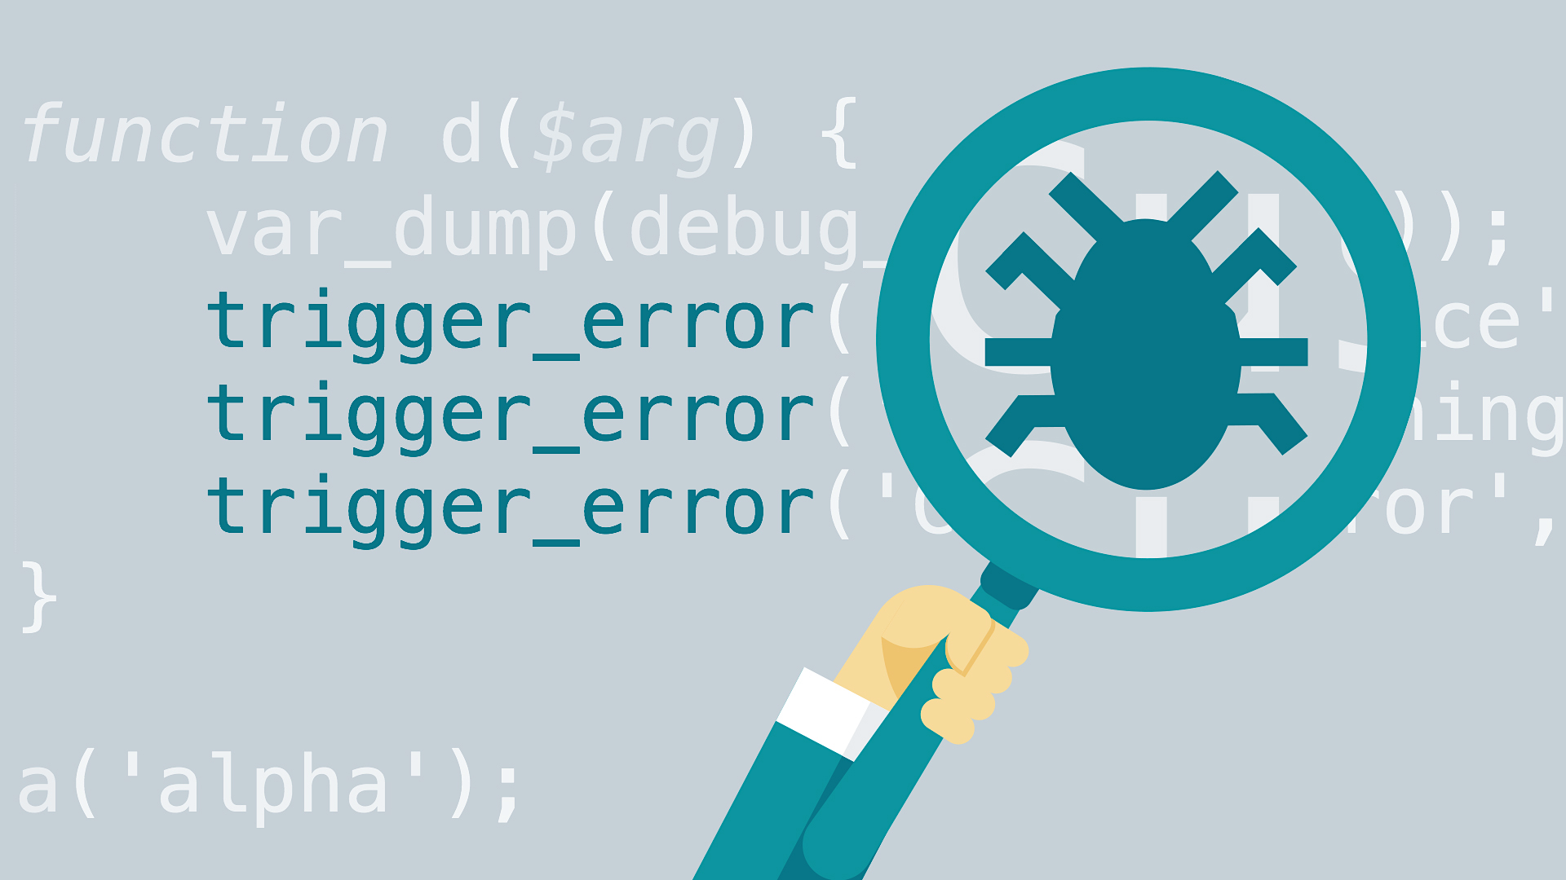
When do I need to debug on Kubernetes?

Slide 4
Two Approaches
Debugging Options
Remote Debugging
Proxy and Simulate
Redeploy debug version of code to cluster
Debug your code as it is running in Kubernetes cluster
Details are language and toolchain specific.
Tools available to automate this process
Simulate Kubernetes on your desktop
Traffic routed from Kubernetes cluster to desktop and back
Examples include Bridge to Kubernetes and Telepresence

Slide 5

Remote Debugging
Local Machine
Kubernetes Cluster
Pod 1
Pod 1
Debugger
Pod 2
Pod 3

Slide 6



Remote Debugging
Local Machine
Kubernetes Cluster
Debugger
Pod 2
Pod 3
Notes:
Mark you set this up, show us
Version of this for Sharmyn

Slide 7
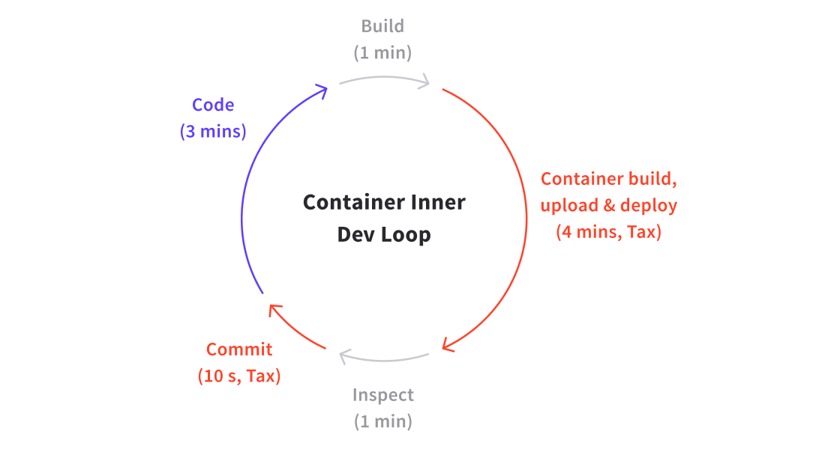
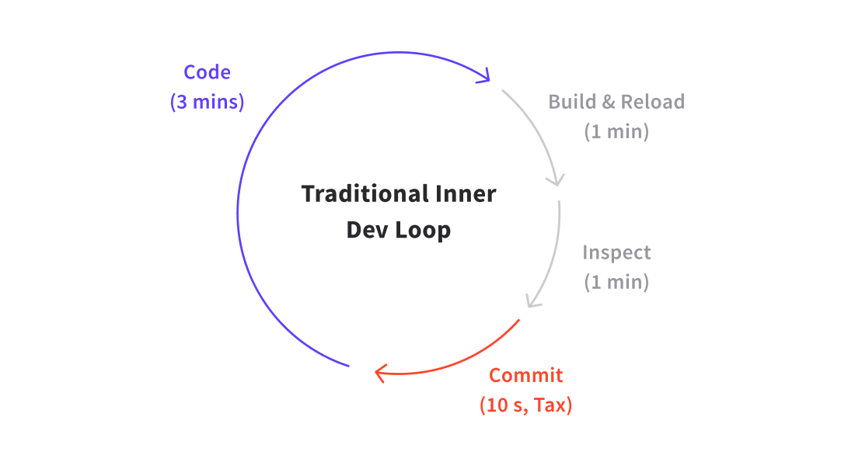
Remote Debugging Cost

Slide 8
Proxy and Simulate
Local Machine
Kubernetes Cluster
Pod 1
Pod 2
Pod 3
Notes:
Mark to talk here

Slide 9
Proxy and Simulate
Local Machine
Kubernetes Cluster
Pod 1
Debugger
Local Process
Proxy
Pod 2
Pod 3

Slide 10
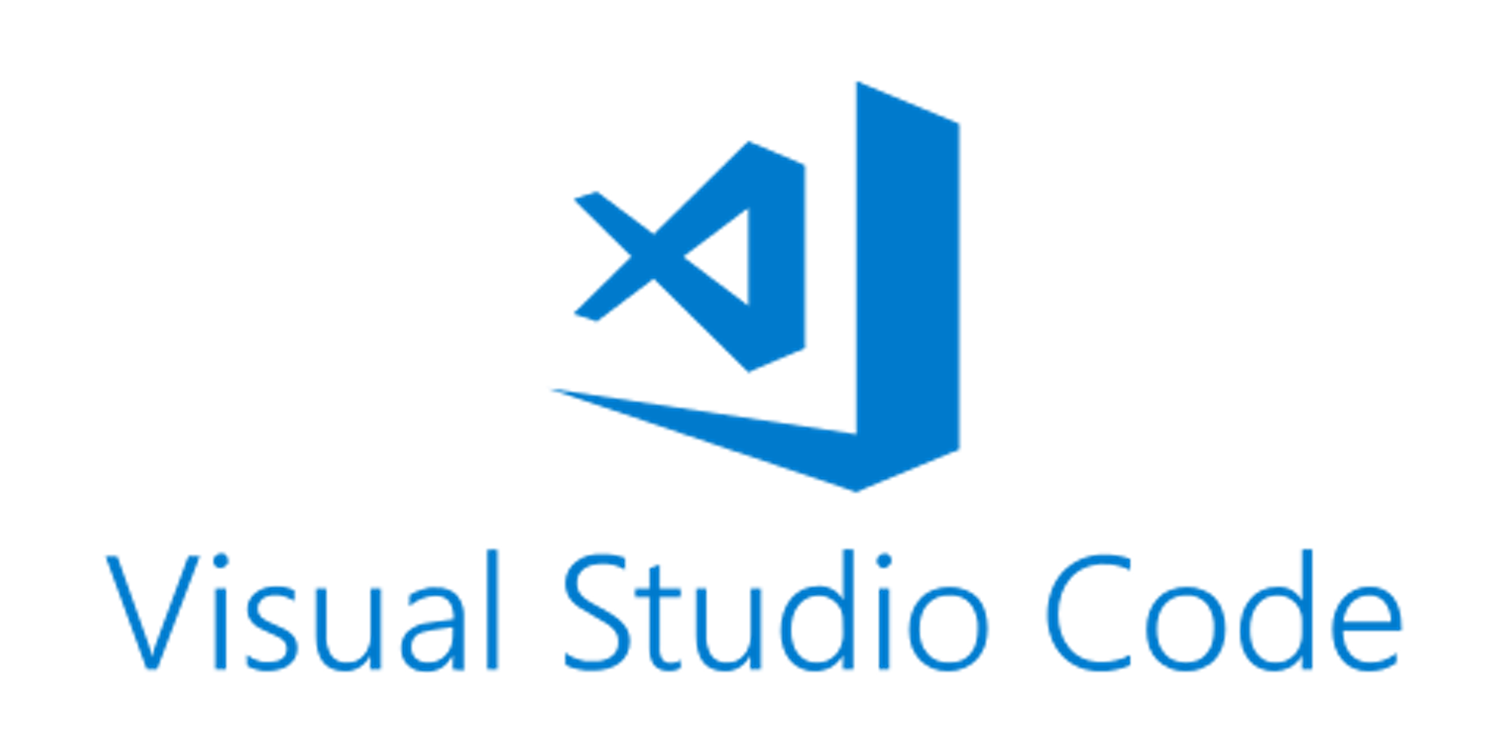
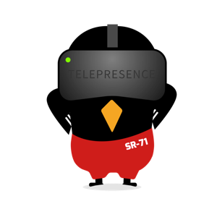

Proxy and Simulate
Local Machine
Kubernetes Cluster
Pod 1
Debugger
Local Process
Proxy
Pod 2
Pod 3

Slide 11
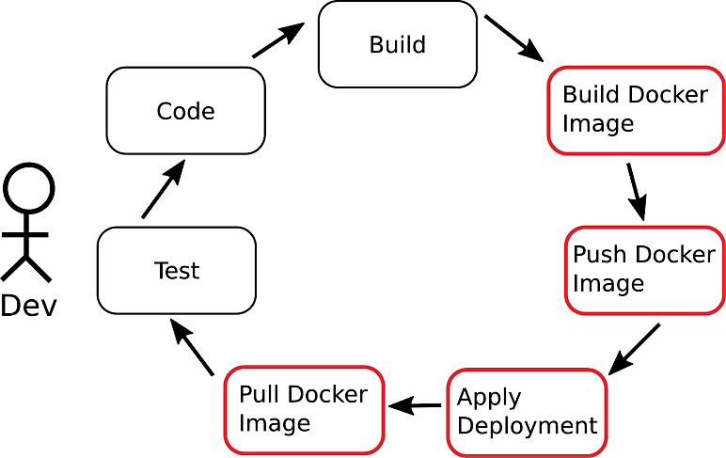
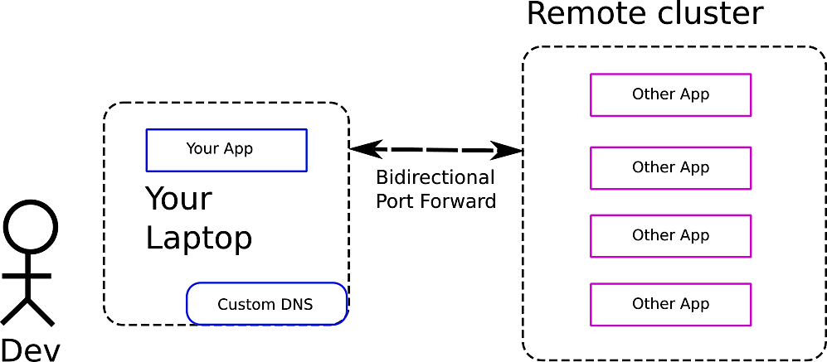
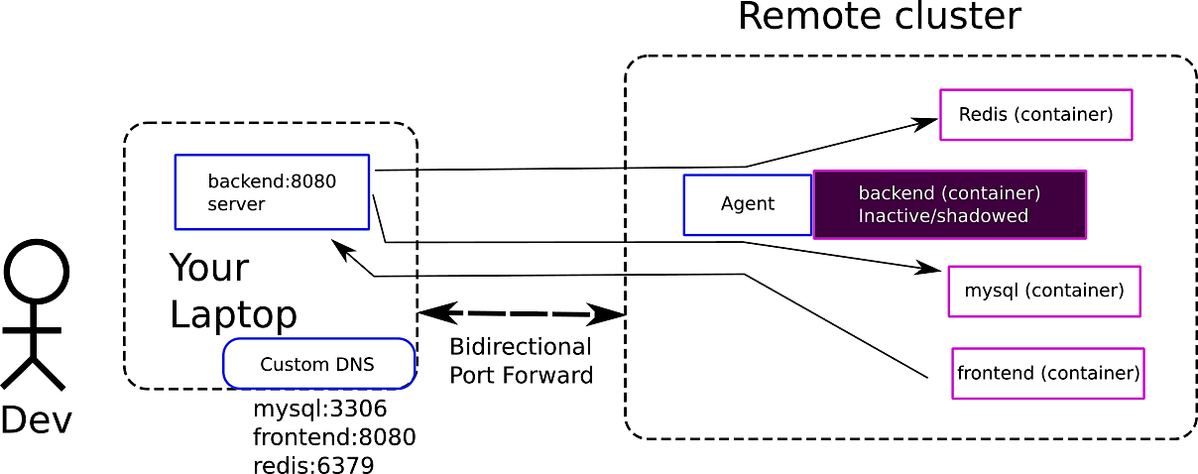
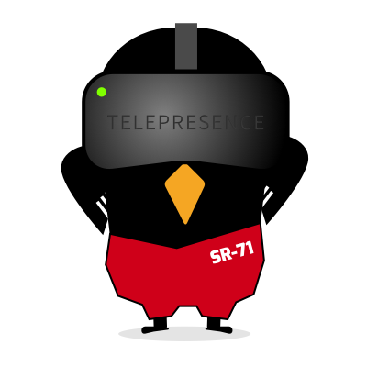
Simulate Kubernetes
Telepresence moves your local workstation inside the Kubernetes cluster
All networking and DNS names available to the pod are now available to your local workstation as well.
Components:
Telepresence runs a global routing agent in the cluster
Bidirectional port forward – secure network tunnel
Each intercepted service gets its own traffic manager
The major problems that Telepresence solves are:
Kubernetes debugging and issue analysis. This is useful for both developers and Kubernetes operators.
Easy local development without a locally running Kubernetes cluster.
Preview environment creation and real time collaboration in a team.
Telepresence essentially cuts down the unnecessary parts of the development loop.

Slide 12
Technique Comparison
Remote Debugging
Slow
Per object setup (automation e.g. draft)
Language specific configuration
Can be used for all object types
No code changes
Proxy and Simulate
Fast
One time setup for cluster/workstation
Language independent
Only works with objects invoked by a service
May require code changes
Volume and environment access
Multi-container pods

Slide 13
Summary
Start with proxy and simulate
Move to remote debugging in circumstances where proxy and simulate cannot be used
Automate the remote debug process
Draft, skaffold debug and others

Slide 14

Please take your survey.

Slide 15
Thank you!

